Slide 1
Unit Visit Tracking System
(UVTS)
Ray Szpiech
District Commissioner - Ojibwa

Slide 2
Agenda
What is UVTS
Getting started with UVTS
Using UVTS
UVTS 2.0 Enhancements
Live Demo of UVTS
Questions & Answers

Slide 3
What is UVTS
Online, web based system
Allows logging and reporting of Commissioner Unit Visits
Allows logging and reporting of Quality Indicators
Allows Focus tracking
Allows Comments
Allows visibility and reporting at District, Council, Area, and National levels
Asks Unit Commissioner and the Commissioner Administrative Hierarchy to be accountable for their responsibility of visiting units

Slide 4
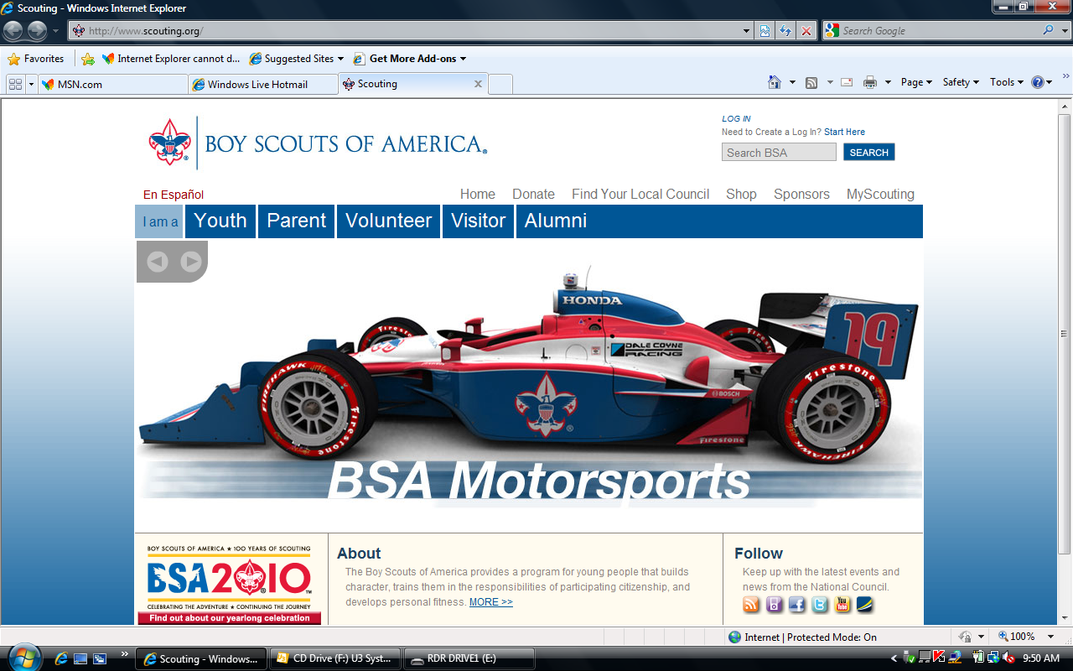
Getting Started with UVTS
#1: www.scouting.org
#2

Slide 5
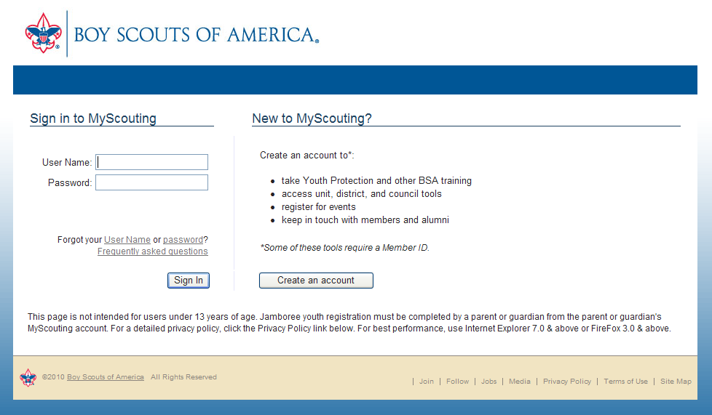
Getting Started with UVTS
Unit Visit Tracking is available through MyScouting for commissioners to electronically submit unit visit reports.

Slide 6
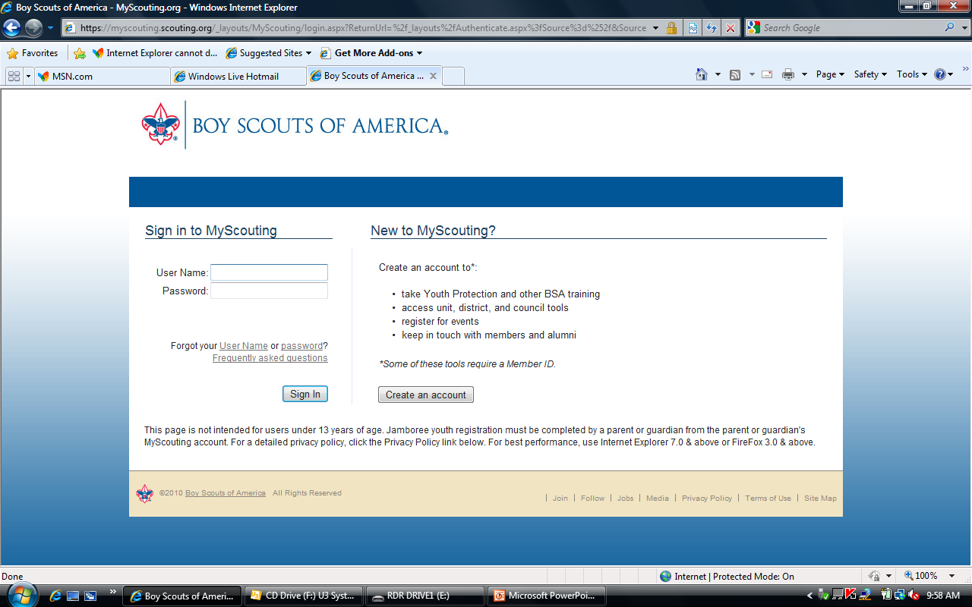
Getting Started with UVTS
Do you need to create your MyScouting Account?

Slide 7
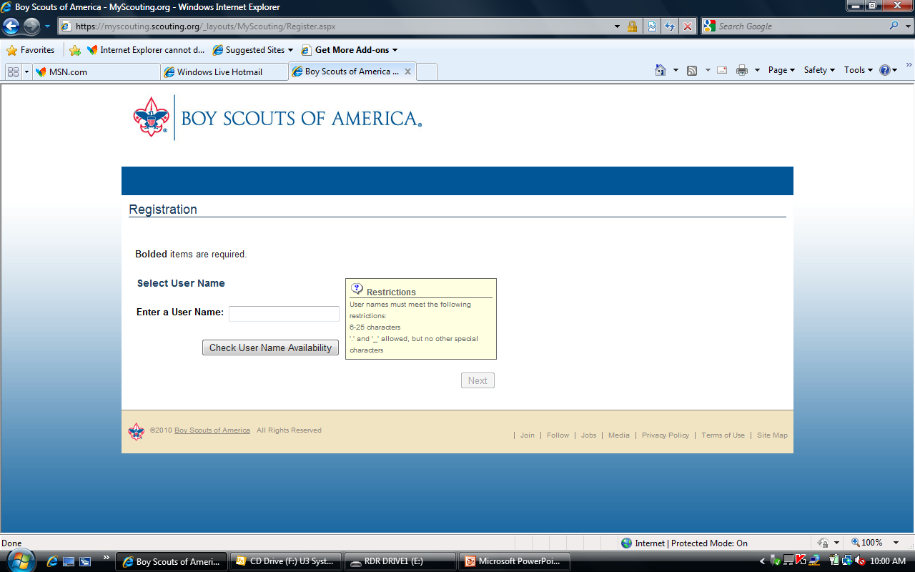
Getting Started with UVTS

Slide 8
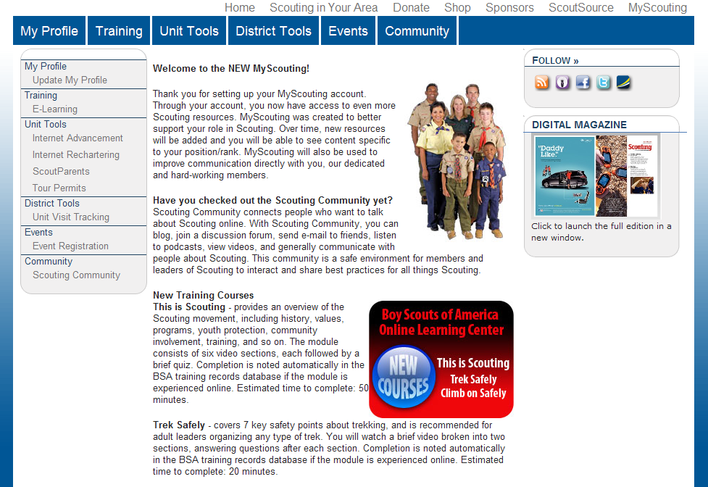
Using Unit Visit Tracking System
MyScouting accessed from www.scouting.org provides applications such as E-Learning, Tour Permits, and UVTS. Each user profile will record the member ID and council that determines the menu items that will be available.

Slide 9
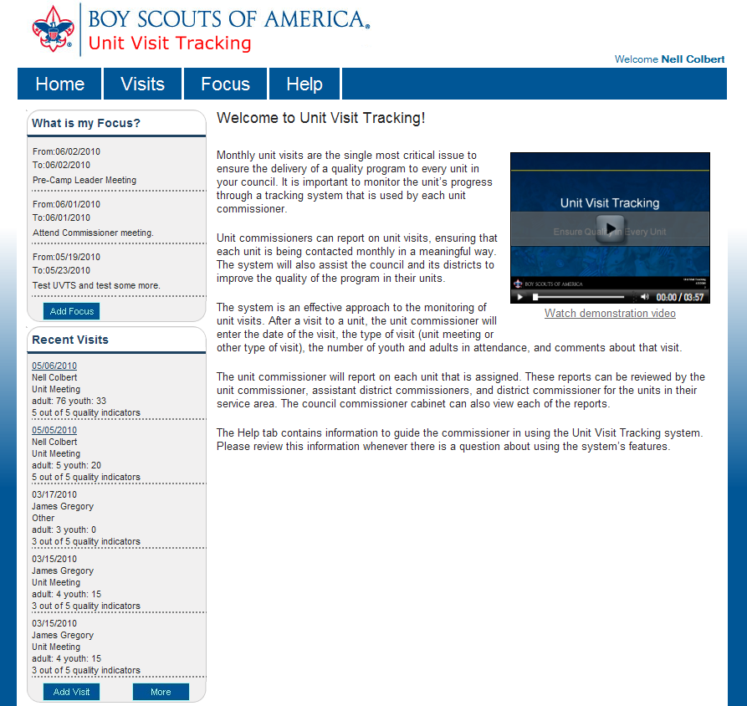
Using Unit Visit Tracking System
Navigation is accomplished with four tabs:
Home - Display Focus and Visits
Visits - Display Visits/Add Visit
Focus - Display Focus/Add Focus
Help - User Help for system
UVTS Home Page
The Home page displays navigation tabs and current entries.

Slide 10
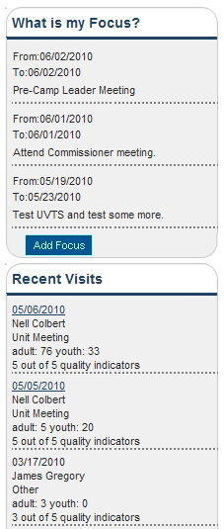
Unit Visit Tracking System
The Home page displays five personal Focus entries in date order beginning with most recent.
The Home page displays five visit reports in date order beginning with the most recent report.
Most recent entries.

Slide 11
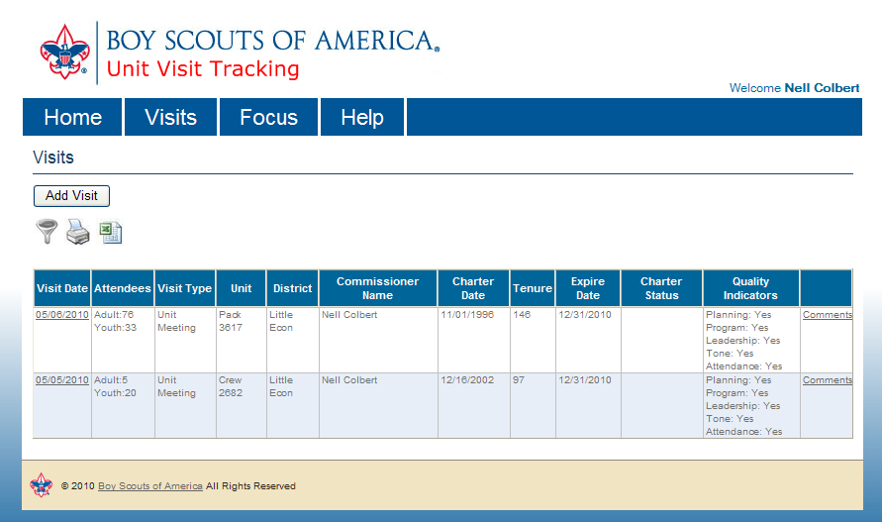
Using Unit Visit Tracking System
Visits page lists unit visit reports.
Reports are available for viewing based upon how the commissioner is registered in the council.
Use Add Visit to enter new visit reports.
Click here to add a unit visit

Slide 12
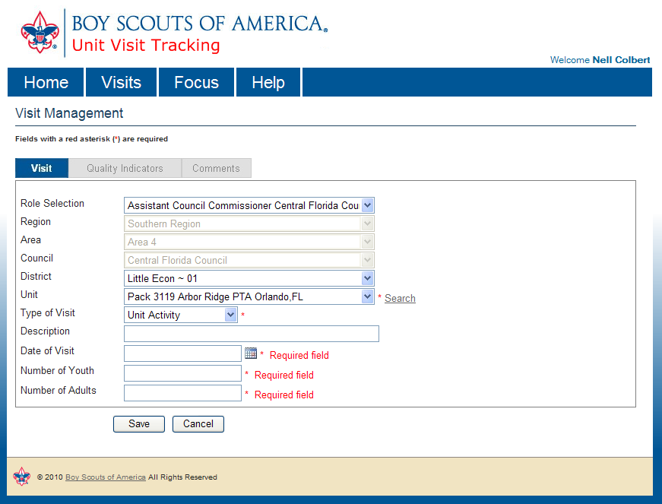
Using Unit Visit Tracking System
Visit Management
is used to make a new unit visit report or edit an existing report.
The information on Region, Area, Council, and District may be auto-filled for the commissioner. The unit will be selected by the commissioner using the pick list or by using Search.
If a saved report is being edited the unit is also auto-filled.
First screen you will see as a Unit Commissioner
Need to go to drop down box to select your unit

Slide 13
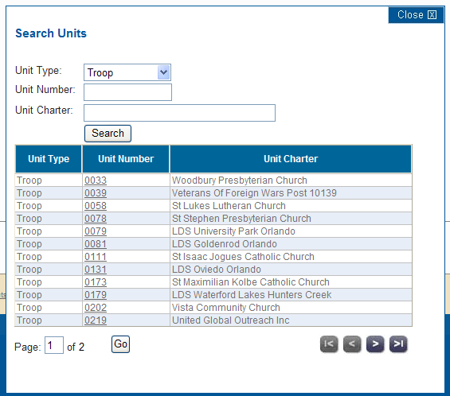
Using Unit Visit Tracking System
Based on the BSA organization level to which the commissioner is registered, Search Units provides the search by
Unit Type,
Unit Type and Number,
Number only,
Or
Chartered Organization name (Unit Charter).

Slide 14
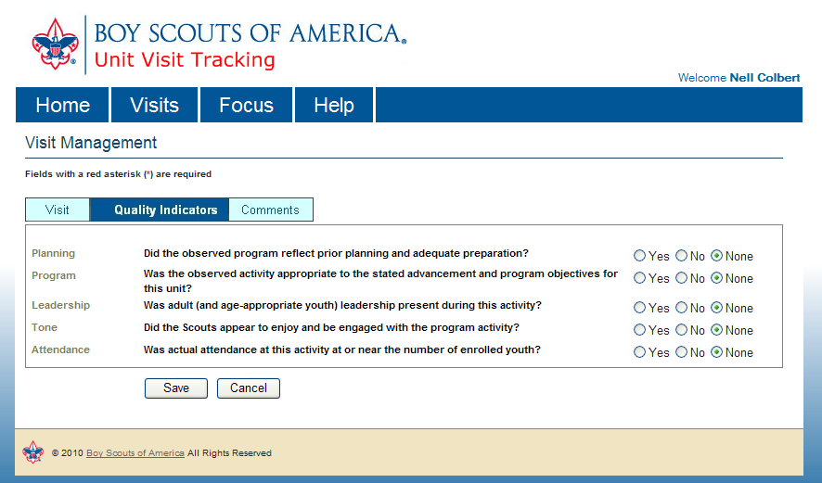
Using Unit Visit Tracking System
Quality Indicators are confirmed by selecting appropriate radio buttons.
Quality Indicators will display on the report summary and are included in the export file report for the unit visit.
Indicators may be edited once saved.
If “None” is selected the Indicators fields will remain empty.

Slide 15
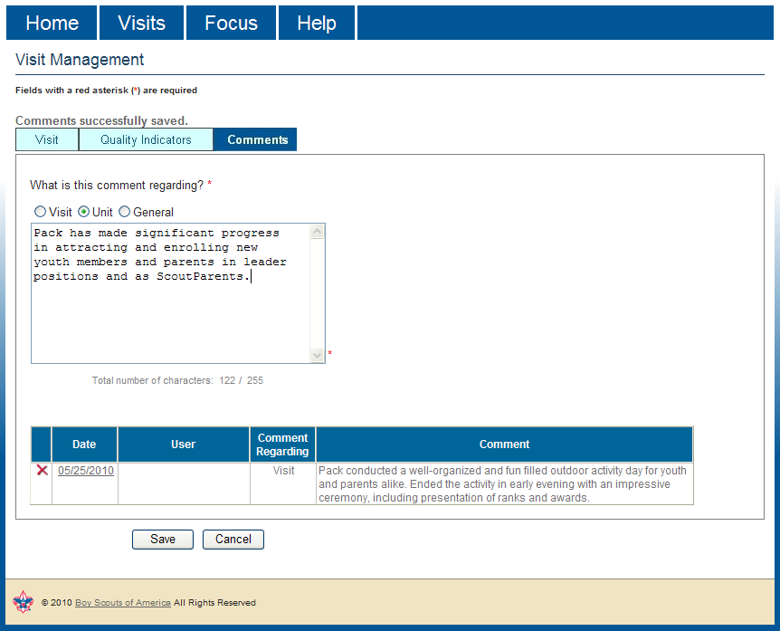
Using Unit Visit Tracking System
Visit Comments for each unit visit may be made. Category for comment is selected and comment is entered and saved.
Report Comments can be edited or removed later. Up to 255 characters allowed for each comment entry.
Comments are added, edited, and removed by the commissioner entering the report.

Slide 16
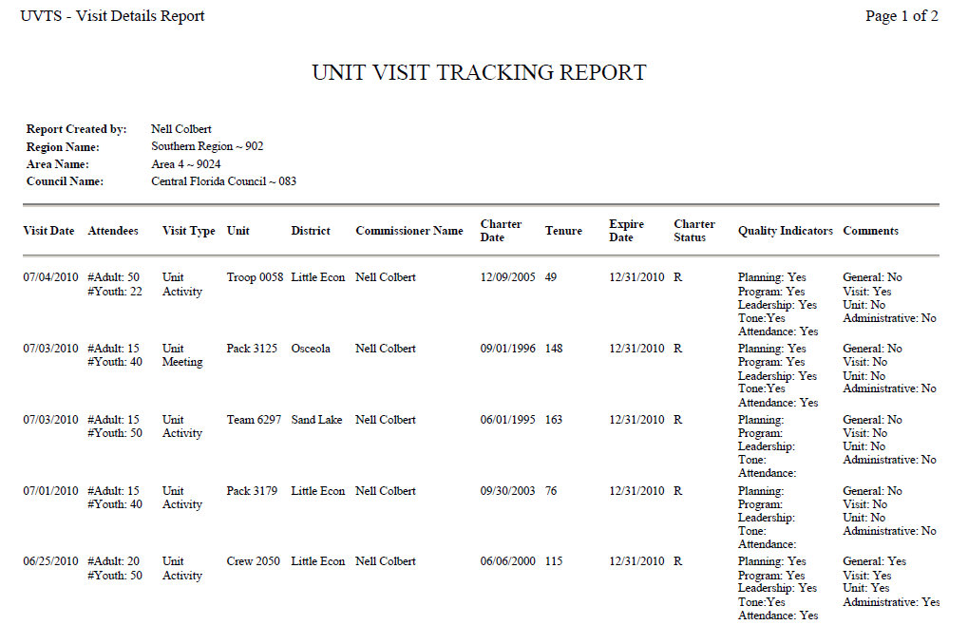
Unit Visit Tracking System
Print Preview PDF provides a summary of visit reports entered for units.
When Print Preview is selected the report is created as a PDF that may be saved unless printing is required.
If visits are filtered first
The PDF report will display these visits.

Slide 17
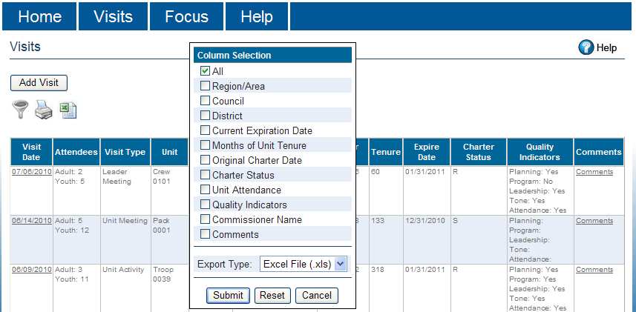
Unit Visit Tracking System
Export Visits List provides a reporting function for Unit Visit Tracking.
The export file shows
all data columns or the user may select fewer columns to export.
Commissioners in council and district positions will see all reports within their organization level.
The Export Type makes available the Excel File (.xls) or the CSV File (.csv) formats for multiple browser use.

Slide 18
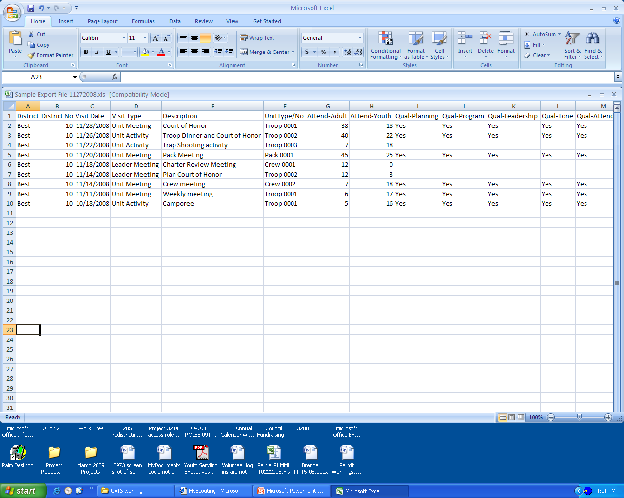
Unit Visit Tracking System
Export Visits allows customization by selecting the columns to include.
Quality indicators will display when selected for export.
Five Indicators:
Planning: Did the observed program reflect prior planning and preparation?
Program: Was it appropriate to the advancement and program objectives?
Leadership: Was adult (and age-appropriate youth) leadership present ?
Tone: Did the Scouts enjoy and be engaged with the program activity?
Attendance: Was attendance at activity at or near number of enrolled youth?

Slide 19
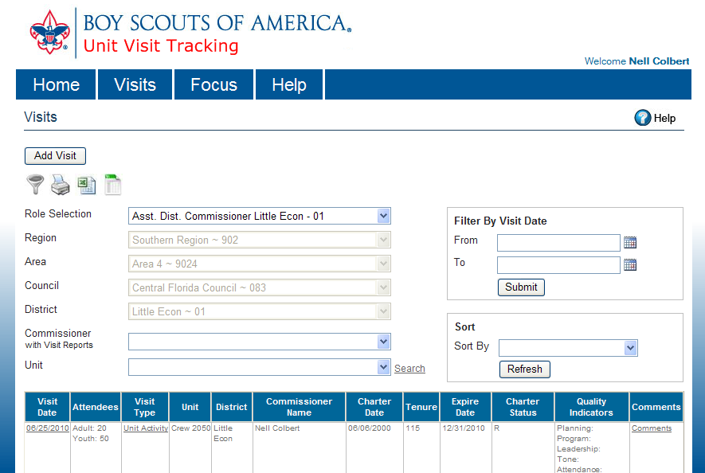
Using Unit Visit Tracking System
Filter allows search for visit reports.
Commissioners will be able to search for specific unit reports by district, by unit, and by date range.
All reports will be viewed based on role selection.
Sort by order for reports is based on charter date, months tenure, expire date, and charter status.

Slide 20
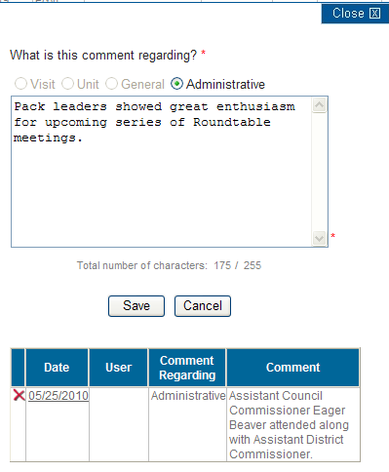
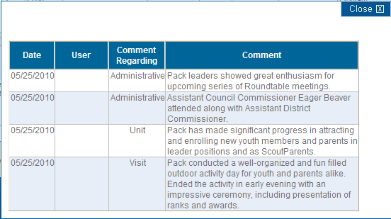
Using Unit Visit Tracking System
Administrative comments may be entered by Administrative Commissioners.
Only authors may edit/delete comments.
All comments made may be viewed in a separate Comments listing for each unit.

Slide 21
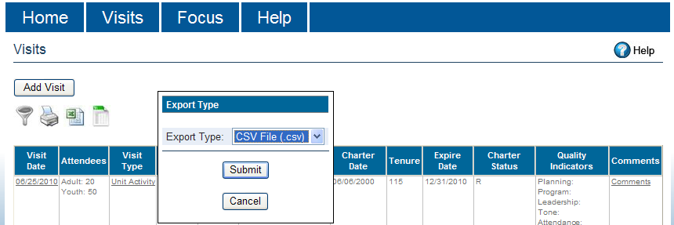
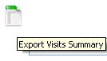
Using Unit Visit Tracking System
The Export Visits Summary is available in two Export Type formats: CSV File (.csv) and Excel File (.xls). This feature will accommodate persons using multiple browsers where different file formats are utilized.
This new feature is added to both export reports.
Click the Export icon to begin.

Slide 22
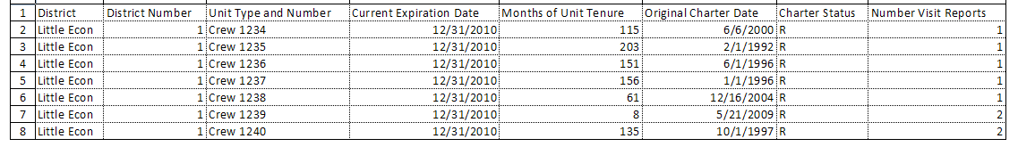
Using Unit Visit Tracking System
The Export Visits Summary includes the following data fields:
Region Current Expiration Date
Area Months of Unit Tenure
Council Original Charter Date
District Charter Status
Unit Type and Number Number Visit Reports

Slide 23
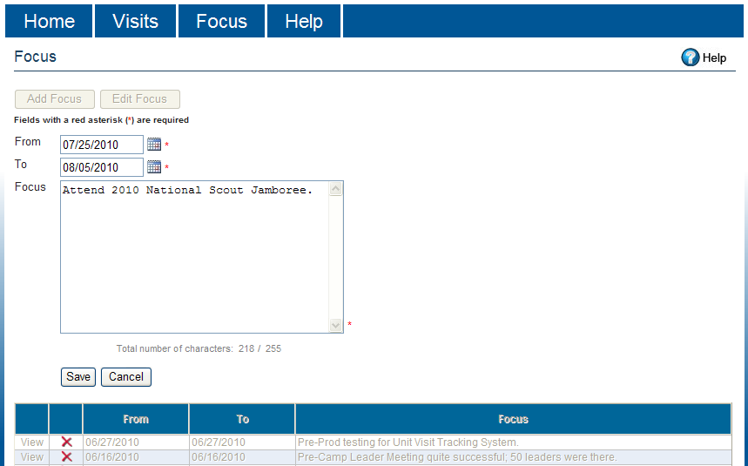
Using Unit Visit Tracking System
Focus tab displays all personal Focus notes made by the user.
This allows a memo for the user on important steps that need to be taken to provide service to units, districts, and councils.
Each Focus may later
be edited or removed.

Slide 24
What’s new in UVTS 2.0
NEW! Unit Visit Tracking (UVTS) has a new look, better navigation, and improved features completing the enhancements requested since the initial December 1, 2008 launch.
NEW! All commissioners may make reports on unit visit contacts and have these reports reviewed by commissioners using the Web-based, self-managed system of Unit Visit Tracking.
NEW! Administrative commissioners may add comments to reports entered by other commissioners based on their assigned council or district organization structure.
NEW! The Export Visits Summary displays all units in the selected organization and totals the number of unit visit reports entered for each unit.

Slide 25
Unit Visit Tracking System
Summary:
The Commissioner must be registered in ScoutNET by the council.
Commissioner creates MyScouting account and enters member ID for account profile.
Unit Visit Tracking System has major new enhancements to improve usability.

Slide 26
Unit Visit Tracking System
Flexible entry of unit visit reports and comments:
Commissioners may add new unit visit reports to any unit within
their organizational structure based on registered position.
Administrative Commissioners may add administrative comments to visit reports within their organizational structure.
Commissioners may view all comments entered for any visit report within their organizational structure from the Comments link.
Only the original visit or comment author may edit or delete entries.

Slide 27
Unit Visit Tracking System
Versatile methods to filter, search, and sort visit reports:
Visits display additional unit data including expiration date, charter date, renewal status, and months unit tenure.
Visits has new filter search by commissioner name and new sort order by expiration date, charter date, renewal status, and months unit tenure.
Search allows the commissioner to find units by type, unit type and number, unit number, or chartered organization name.
The filter and sort utility assists in customizing how reports are viewed.

Slide 28
Unit Visit Tracking System
Power in reporting tools:
The Export Visits List is expanded with additional data fields and the administrative comment. The files export in two format types.
The PDF format is improved and expanded with more information in the summary format. The report may be previewed and saved.
The Export Visits Summary provides a listing of all units within the organizational structure and number of visit reports for each unit.
The reporting tools track unit visits and vital statistics on unit health.

Slide 29
Unit Visit Tracking System
Live Demo

